Slide 1
Intercultural Education
Alex, Bre, Carlie and Donri
Charlie and his Angels

Slide 2
Summarizer/Visualizer

Slide 3
Intercultural Competence
Schema Activation
Notes:
Before we move to the summary lets activate our schemas.
Raise your hand if you have travelled to another country.
Keep your hand up if it was outside of N.A.
Keep your hand up if the national/common language was not english.
You can put your hand down.
Reflect for a moment about your experience in the country/countries. If you haven’t been outside of Canada reflect on an experience within a different culture in Canada.
Were you Uncomfortable? Anxious? Excited? Confused by customs? Did you experience culture-shock?
Take a moment to discuss with your table partner.

Slide 4
Article: Developing intercultural understanding and skills: models and approaches
The purpose of the article is to define:
1st: What is intercultural competence.
2nd: How to develop intercultural competence.
3rd: How can intercultural competence be measured?
Laura B. Perry & Leonie Southewell

Slide 5
Summary
The article is a summary and comparison of research on intercultural competence and intercultural education. Perry and Southwell (2011) discussed the importance of intercultural competence because intercultural interactions are becoming a part of daily life (p. 453). As an educator this is important as we will need to develop intercultural competence to work with diverse students and teach intercultural skills.
Notes:
The first section of the article describes what intercultural competence is. Intercultural competence includes intercultural understanding, intercultural sensitivity and intercultural communication. These will be defined later in our presentation.
The second part of the article discusses how to develop intercultural competence. The article noted that the development of cultural competence cannot be fully attained without experiencing cultural differences. To grasp and practice intercultural competence the learning will need to become more experiential. The culture needs to be critically analyzed through being placed in context and studied within multiple world perspectives.
Lastly, the article discusses how to measure intercultural competence and that intercultural competence should be measured.
One model discussed and is widely used is the Developmental Model of Intercultural Sensitivity, by Bennett, updated in 2013. It is noted that one model may not be able to measure all of the components of intercultural competence.
This model and other models have been scrutinized and questioned for their validity by many researchers. And will be discussed later in our presentation.

Slide 6
Intercultural competence is like climbing a mountain

Slide 8
Webber/Questioner

Slide 9
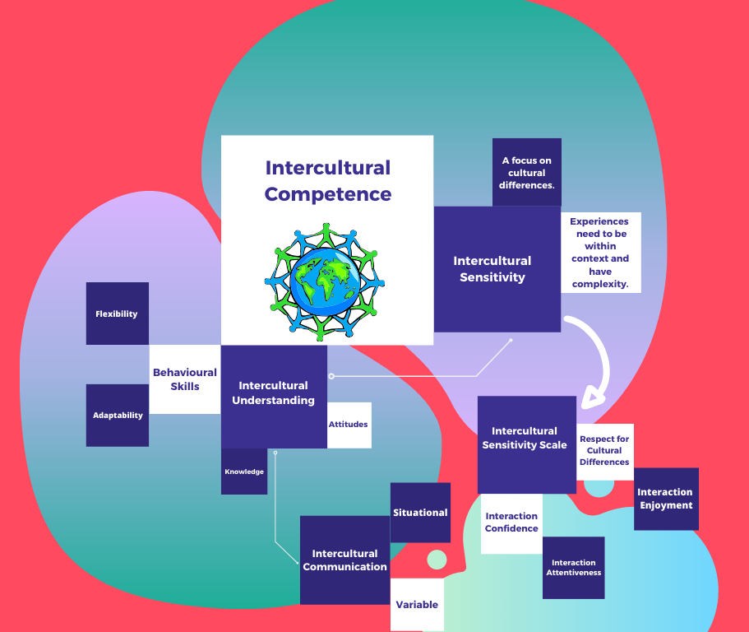
Perry, P. B., & Southwell, L. (2011)

Slide 10
Question #1
How do we address ethnocentrism with students?
When addressing the issue of ethnocentrism with students it is crucial to face the initial fact that teachers are the ones who often unintentionally pass on their own beliefs. Once action has been taken to address our own biases the next step is to understand the other origins of students’ preconceptions. At early development stages students pick-up ideologies and perspectives from their immediate families and people in their lives. With limited experience and external cultural knowledge, young children’s views of others are often formed within a limiting environment. Ethnocentrism is classified as viewing one’s culture as “central to reality” and positioned on the other end of the spectrum is Ethnorelativism. Ethnorelativism describes viewing one’s culture as “relative to context”. Giving context to views of different cultures is how teachers can pull students away from a limited scope of understanding.

Slide 11
The Developmental Model of Intercultural Sensitivity
(Bennett, 2014)
Notes:
The Developmental Model of Intercultural Sensitivity
How cultural differences are being experienced
Ethnocentrism own culture is “central to reality”
Ethnorelativism: “relative to context”
Denial or no perception of cultural difference. Believe that one’s own culture is more complex, view the other as foreigner
Defense: Us and them
Cultural differences are stereotyped and critical of different cultures
Minimization: believes own culture/worldview are universal. Believe that everyone shares the same experiences.
Acceptance: experience one’s own culture as just one of multiple and complex world views. Acceptance and curious of different cultures.
Adaptation: “generating appropriate alternative behaviour in a different cultural context” (Bennett, 2014). People here can adapt and use their intercultural sensitivity and intercultural communication competence.
Integration: “an experience of self that is expanded to include the movement in and out of different cultural worldviews” (Bennett, 2014) cross cultural awareness.
Goal is to create students who practice ethnorelativism. The ability to relate your own culture to a different culture within context.

Slide 12
Question #2
How can we increase intercultural competence with students?
This question stems from the statement that there is limited availability of structured training programs and opportunities for travel to build cultural competence with students. By stating this it can be inferred that these are the only avenues to enrich cultural competence in the classroom. As mentioned in the article, we simply cannot rely on fact-based knowledge to create a well-rounded level of intercultural competence in our students. The authors mention the exploration of other approaches to develop the affective and behavioural skills that are required to change or influence a cultural mindset but they fail to mention any specifics. If a full sense of intercultural competence is attributed to the exposure of targeted training and experience, why can’t we as educators try to bring that aspect into our classrooms through local experience opportunities?

Slide 13
Question #2 Cont.
We can create diverse and culturally sensitive lesson content that brings social skills and mindful perspectives to the forefront. Creating this environment allows students to develop attitudes such as empathy, curiosity, and respect that further their understanding much more than theoretical study and can be applied when they do have the chance to fully immerse themselves in new cultures. Despite the observation made by the authors that there are very few training programs on intercultural competence there are many opportunities provided by many local locations, events, and individuals that can give purpose and exposure to intercultural understanding and the celebration of difference.

Slide 14
Expanding cultural experiences and a global mindset in the classroom examples
Have a calendar with all cultural holidays.
Celebrate multiple cultural festivals in the classroom and community.
Study cultural histories, flags of all countries, listen to their national anthems and play games/sports from multiple countries.
Discuss different forms of communications, types of body language and customs.
Read historical fiction novels about different cultures.
Watch foreign films with subtitles.

Slide 15
Wordsmith/Passage Picker

Slide 16
Definitions
Intercultural Competence (Behaviour/Communication): Achieved through different cultural experiences. It encompasses intercultural understanding, intercultural sensitivity and intercultural communication. Intercultural competence includes the person’s ability to adapt and integrate into a different culture, as well as understand multiple worldviews and perspectives. The development of intercultural competence is intricate and involves various layers of understanding, connection and context. It includes knowledge, skills, attitudes and behaviours. Ex: Working as a teacher at a private First Nations elementary school and immersing yourself in extra-curricular activities.
Intercultural Understanding (Knowledge/Awareness): Experiences that are not shaped by biases and stereotypes. A person with intercultural understanding can recognize similarities and differences in reference to their own culture, see their own culture as one example of a culture, and recognize that there are multiple perspectives and worldviews. In this way of thinking, the person’s understanding of other cultures is in a positive framework. Ex: Having issues connecting with a student’s parents.
Intercultural Sensitivity (Empathy/Affective Response): “A person’s ‘active desire to motivate themselves to understand, appreciate and accept differences among cultures’ (Chen and Starosta 1998, 231)” (Perry & Southwell, 2011, p.454). An Intercultural Sensitivity scale developed by Chen and Starosta (2000) includes these factors: interaction enjoyment, respect for cultural differences, confidence in interactions, and attentiveness of the interactions (Perry & Southwell, 2011, p.454). Ex: Actively creating opportunities for engagement, inside and outside the classroom.

Slide 17
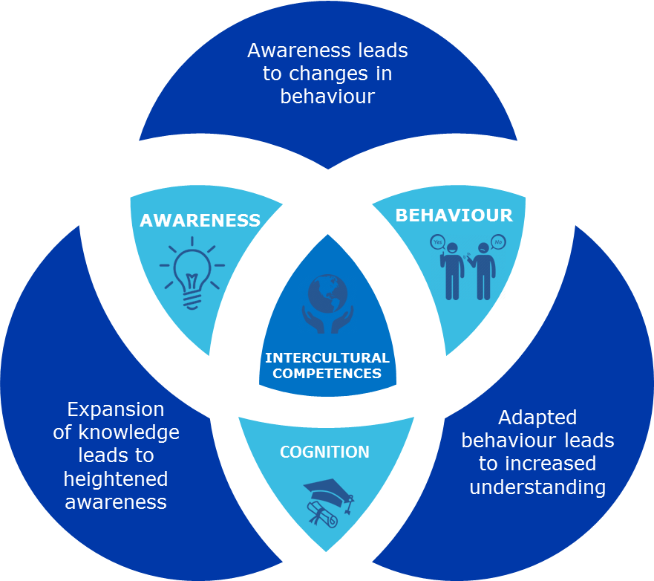

Slide 18
Passages
1) “In school settings, education for intercultural competence, if it is taught at all, is typically embedded in an academic subject such as foreign languages or social studies. However, the degree to which subjects such as foreign languages and social studies are intercultural depends on the orientation of the curriculum (Davies and Read 2005)” (Perry & Southwell, 2011, p.458).
2) “Inquiry-based learning is used to help students understand that people can hold different worldviews, to examine those views and respect them, although not to necessarily accept them (Stathers 2008). An important aspect of this curriculum is the encouragement of critical inquiry and interaction with local communities and cultures” (Perry & Southwell, 2011, p.458).

Slide 19
Actualizer

Slide 20
Developing Intercultural Competence
Simply acknowledging another culture does not build intercultural competence.
Learning alternative worldviews through a critical lens will help develop intercultural competence.
Communication can be interpreted differently, even by members of the same culture
Communication is a recognition of a difference in culture through the spoken language
Our activity will create an awareness of cross culture communication barriers
Notes:
Intercultural Communication:
Intercultural communication is not a focus of the research in its influence on intercultural competence due to the multiple variables. Communication can be interpreted differently by members of the same culture, it is an individual characteristic and it can be situational. There are some similarities among cultures on how they communicated, however, the variables have made it difficult to prove in research. Communication is a recognition of a difference in culture through the spoken language.

Slide 21
Activity

Slide 22
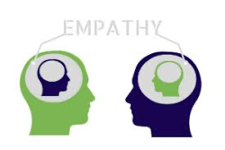
“Walk in Their Shoes”
Outcome statement:
Upon completion of this activity, students will appreciate the effort that ESL (English as Second Language) learners, or new second language learners exert while communicating in their non-primary language.
To encourage intercultural sensitivity and increase
Intercultural competence.

Slide 23
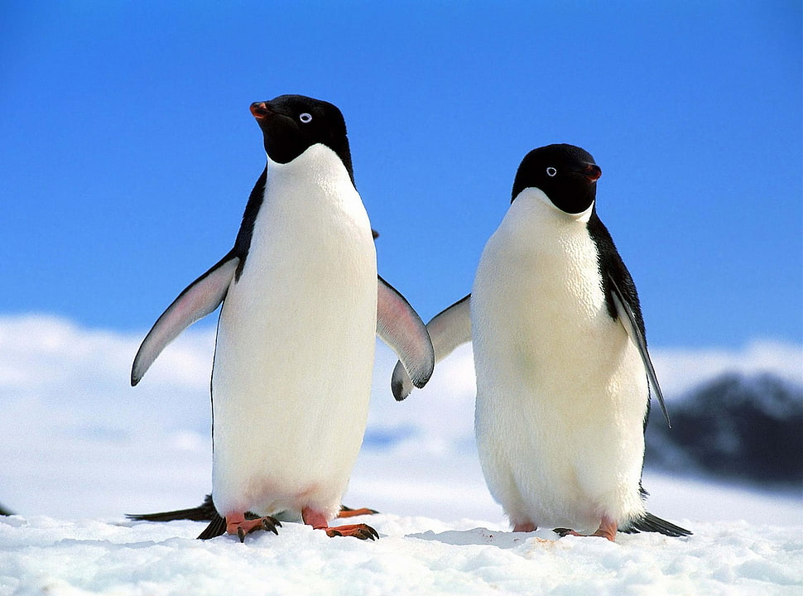
Time to pair up!
Please get into groups of
TWO

Slide 24
Decide who will go first...
Tell your partner about the town you grew up in.
BUT...
As you do this, you must “insert” a COLOUR approximately every 5th word!
Example:
“I grew up in a PURPLE city called Burnaby. I lived YELLOW near a fun lake ORANGE called Deer Lake where PINK I would often go swimming.”
GO! After TWO minutes we will get you to switch partners.

Slide 25
Let’s Debrief:
Ask each other the following questions:
How did you feel when you were the speaker? What did you do?
How did you feel when you were the listener? What did you do?
How effective were you?
What did you learn?
How can you use this awareness as you interact with others who are speaking a second or third language?

Slide 26
Perry, P. B., & Southwell, L. (2011)
Notes:
Activity doesn’t check all the boxes of intercultural competence
We may not always know the context for a lack of communication between cultures (family disputes, political, etc)
An outward sign of tolerance may not indicate an inner respect for another culture
Inability or unwillingness to communicate may stem from lack of confidence or fear of misunderstanding
Don’t jump to conclusions! Know the context!
As we increase our intercultural sensitivity, we gain more intercultural competence

Slide 27
Would anyone like to share?
We would like to hear from a few groups:
How did this activity make you more aware of the difficulties that a non-English speaker might have trying to communicate?

Slide 28
Works Cited
Bennett, M. J. (2014). The Development Model of Intercultural Sensitivity. Retrieved from Intercultural Development Research Institute: https://www.idrinstitute.org/dmis/
Cassidy, Patricia A., Stringer, Donna M. 52 Activities for Improving Cross-Cultural Communication. Pages 21 – 23. Retrieved from:
https://www.mobt3ath.com/uplode/book/book-56008.pdf
Chen, G.-M., and W.J. Starosta. 1998. Foundations of intercultural communication. Boston,
Clavel, T. (2019). World Class: One Mother’s Journey Halfway around the globe in Search of the Best Education for Her Children. New York, NY: Astria Books.
Perry, L. B., & Southwell, L. (2011). Developing intercultural understanding and skills: models and approaches. Intercultural Education, 22(6), 453-466.
MA: Allyn & Bacon.

