Slide 1
Donri Helmer PLAR Portfolio T00599672 E.14.8
Photo Evidence for Life-Learning
(All photos are used with permission)

Slide 2
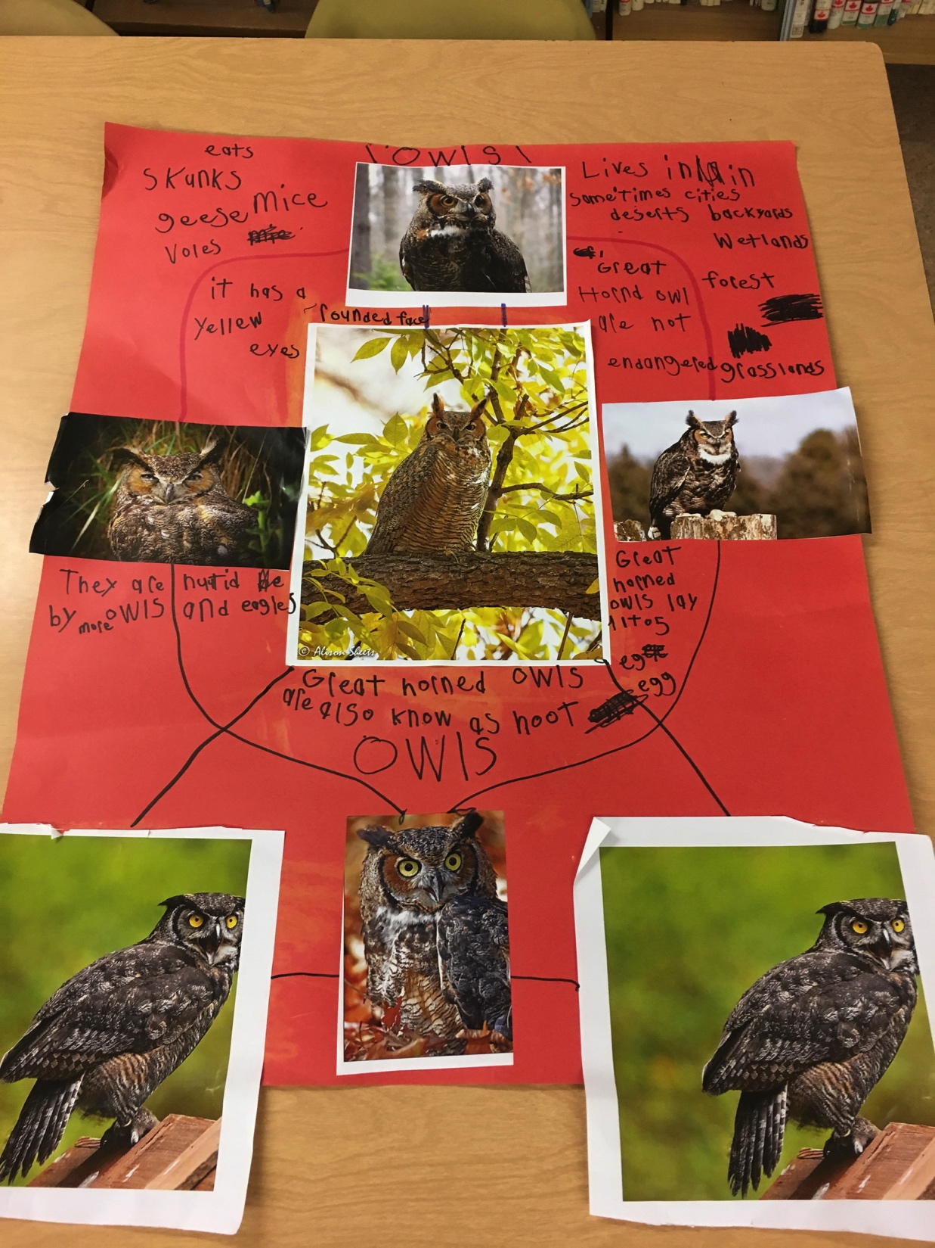
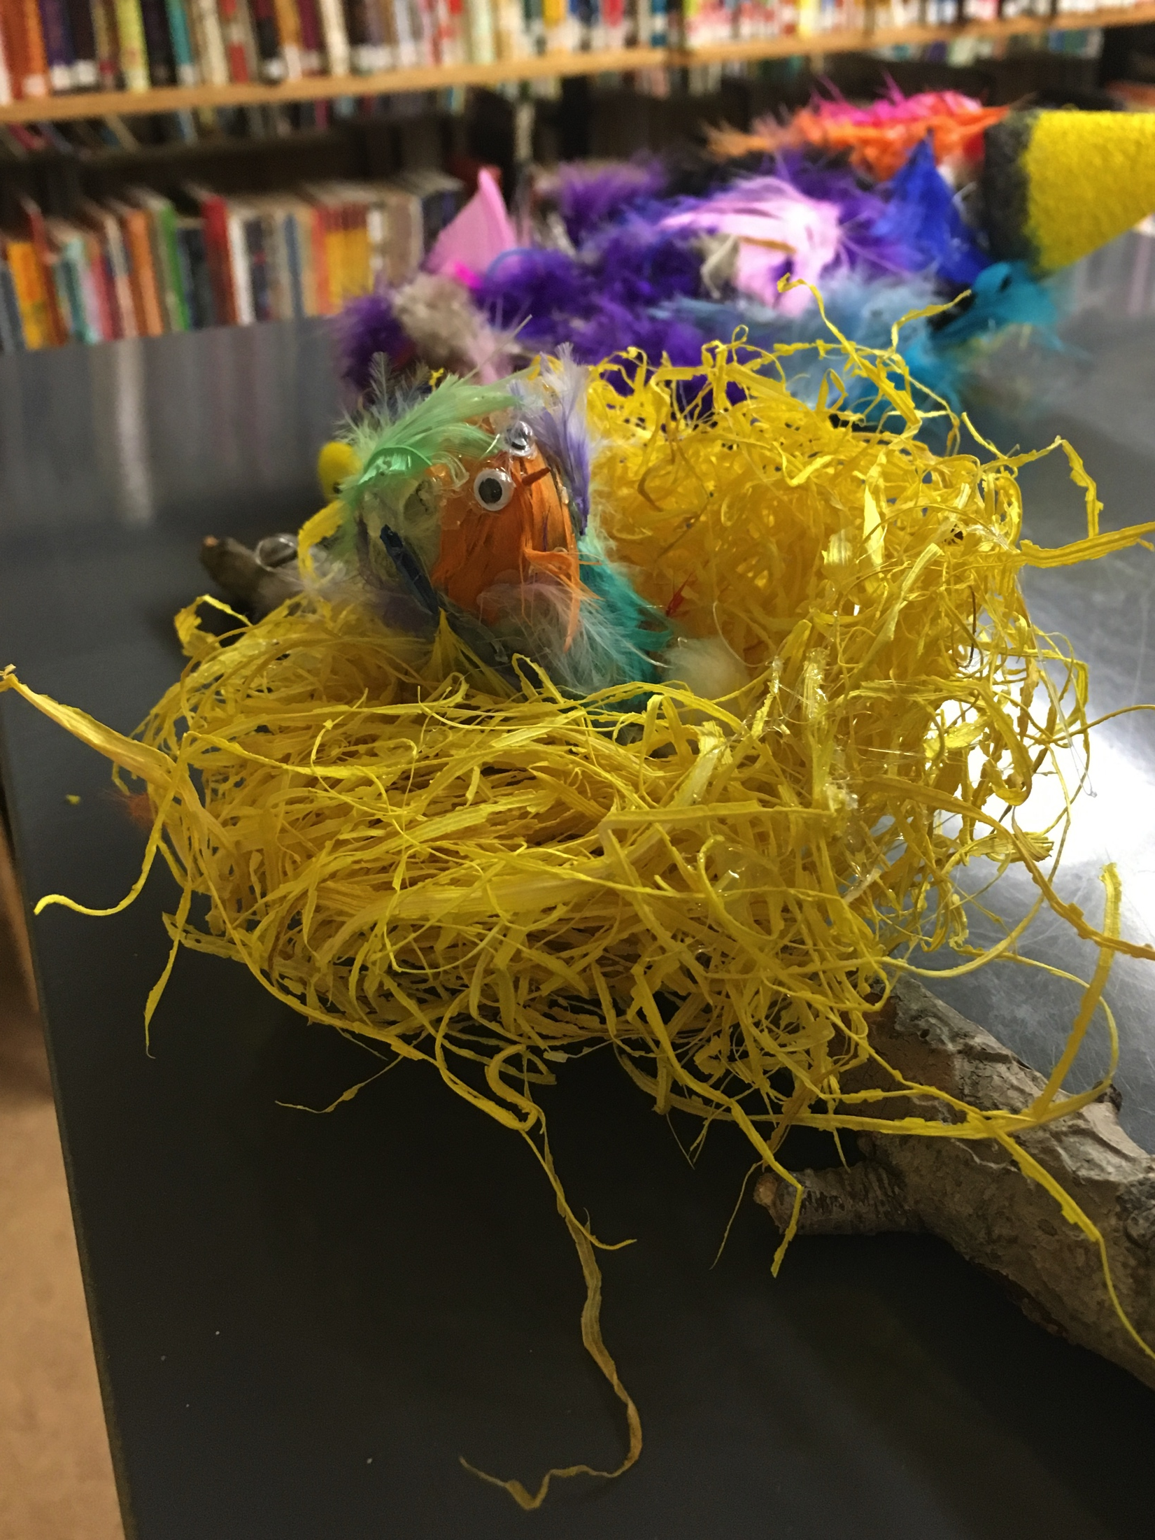
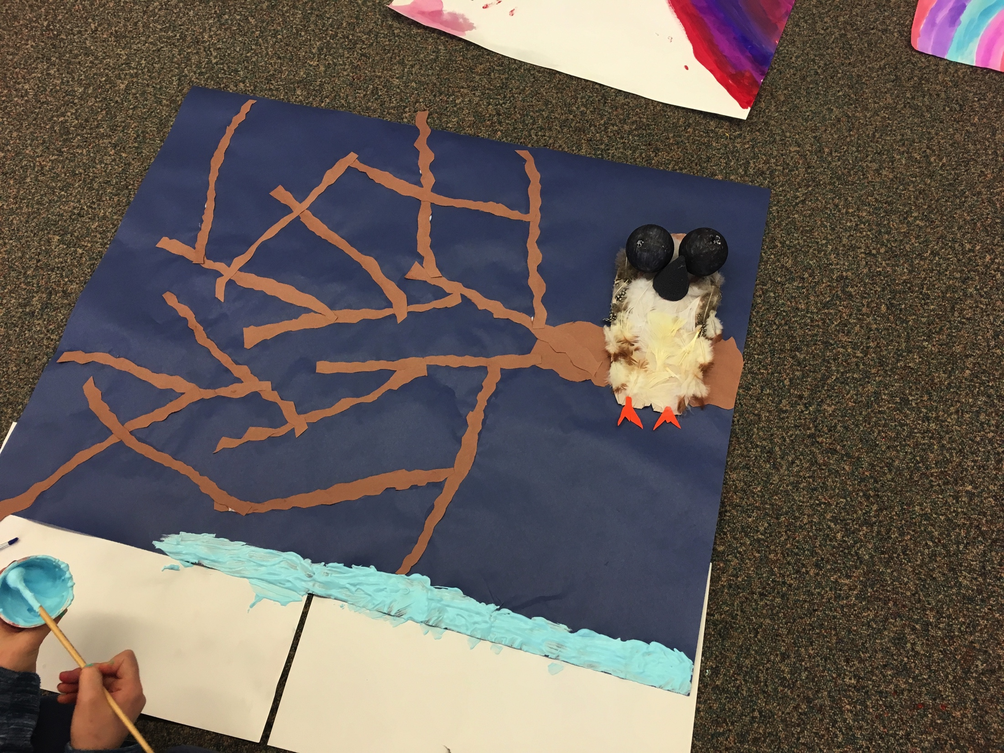
Lac La Hache Elementary
Working on Science inquiry projects

Slide 3
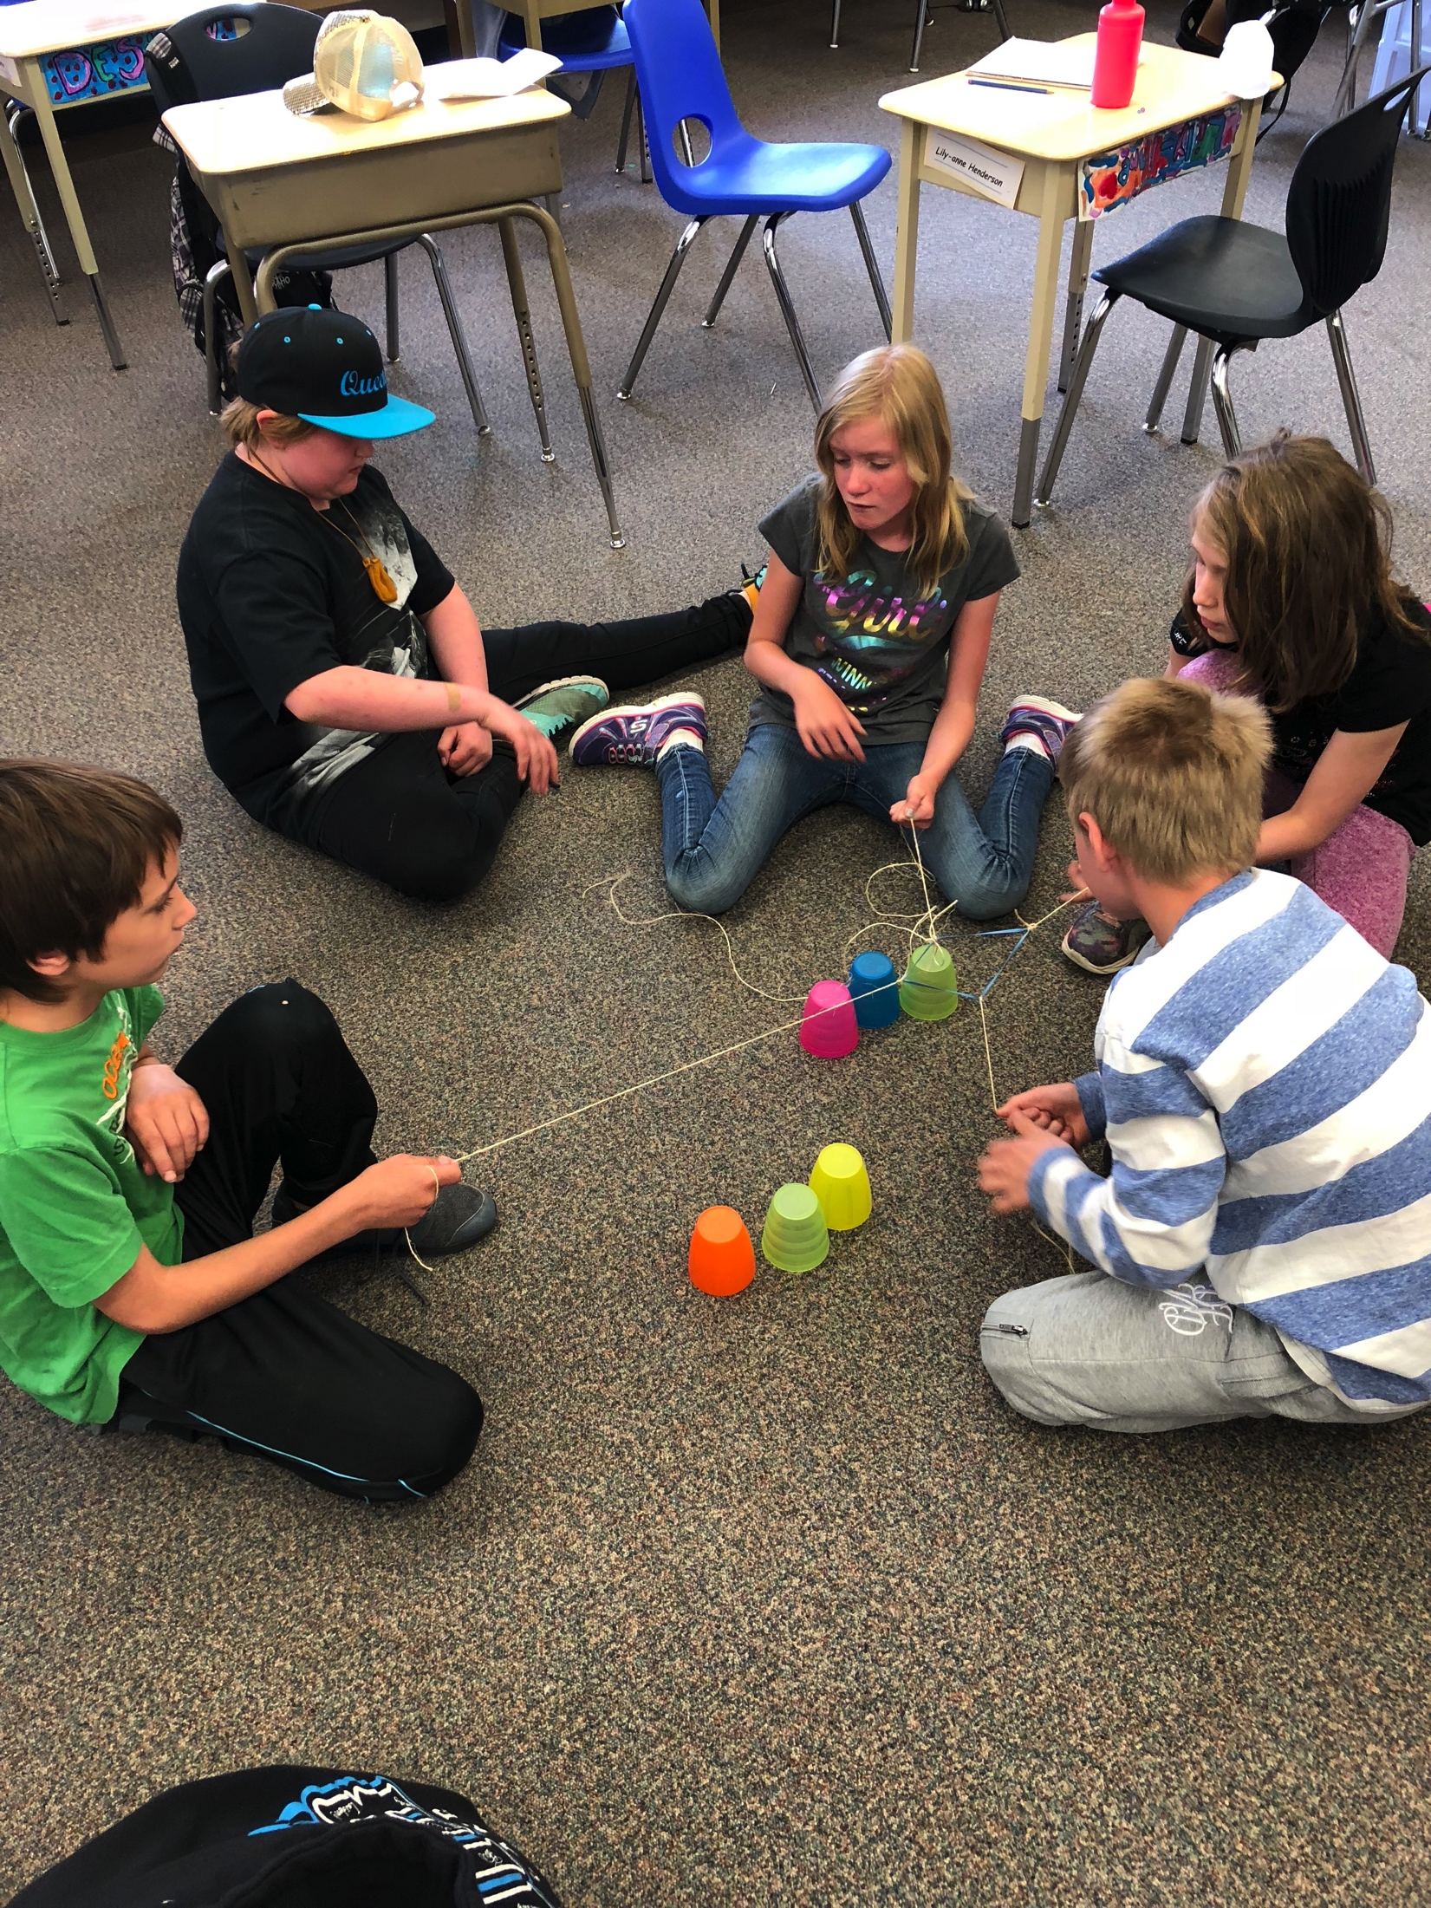
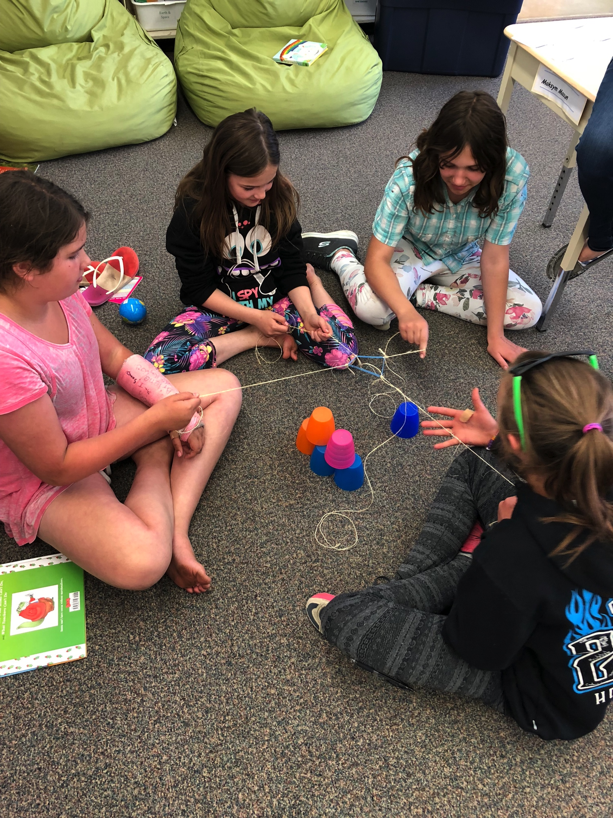
Hands-On Science
Working together to learn about the muscular system:

Slide 4
First Nations Drum Making

Slide 5
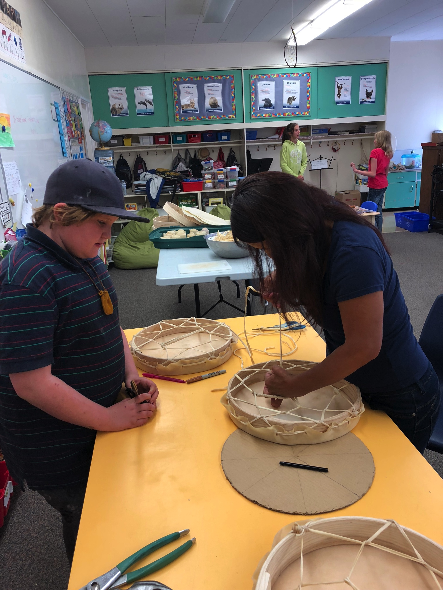
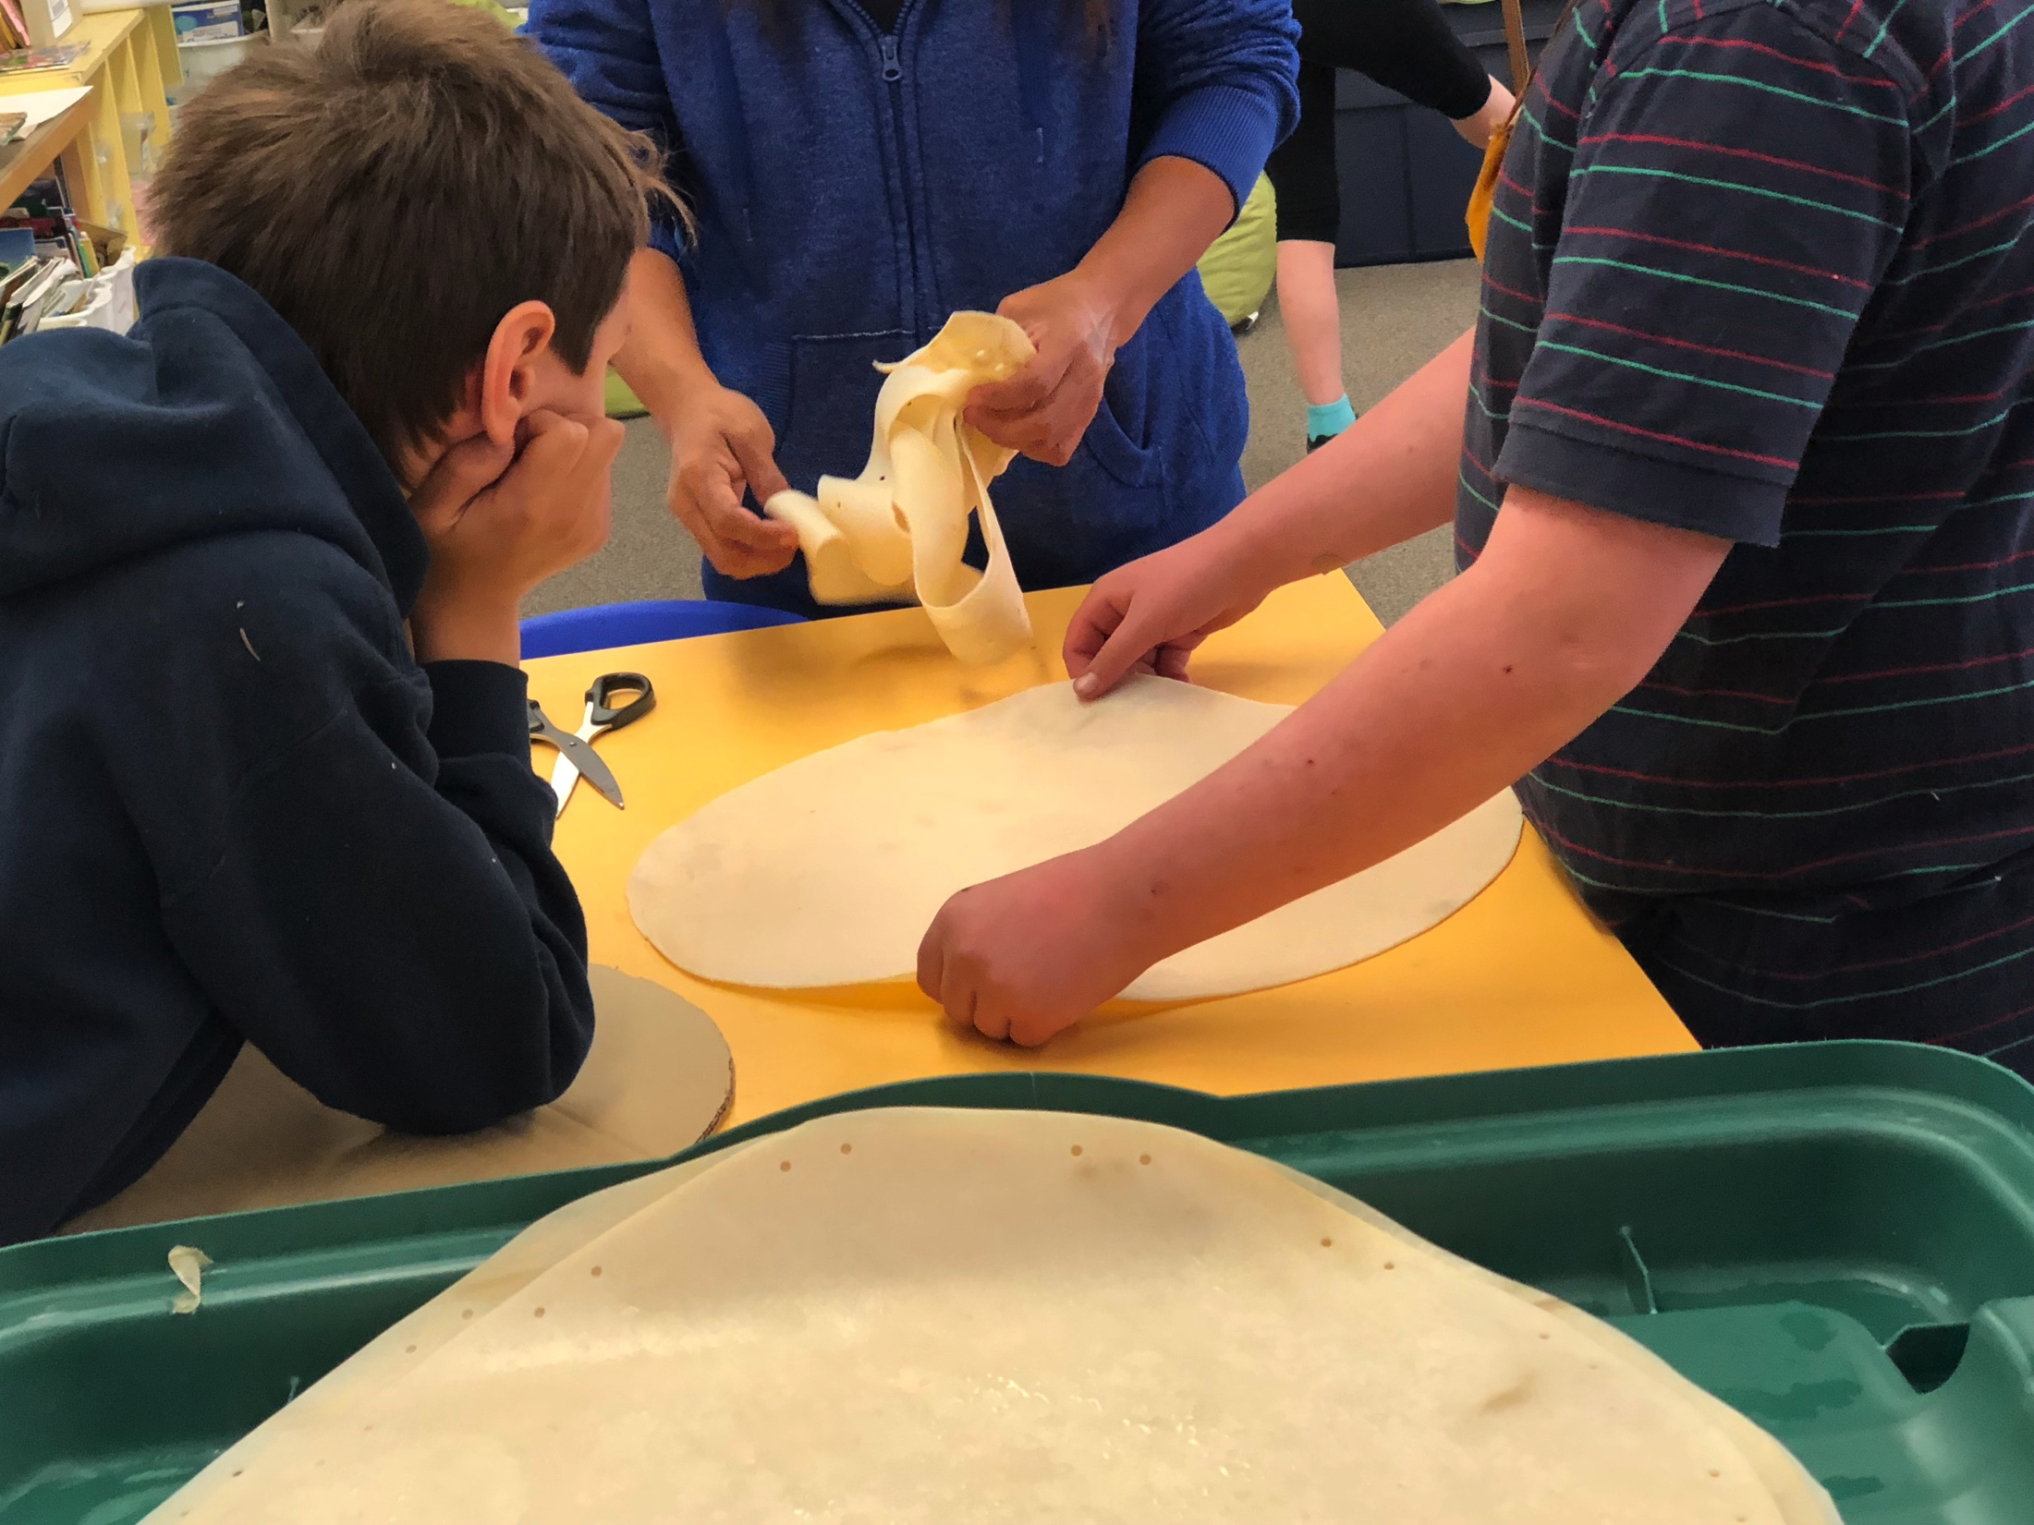
Our sincere thank-you to Cheryl Archie!
Each student participated in making their own drum.

Slide 6
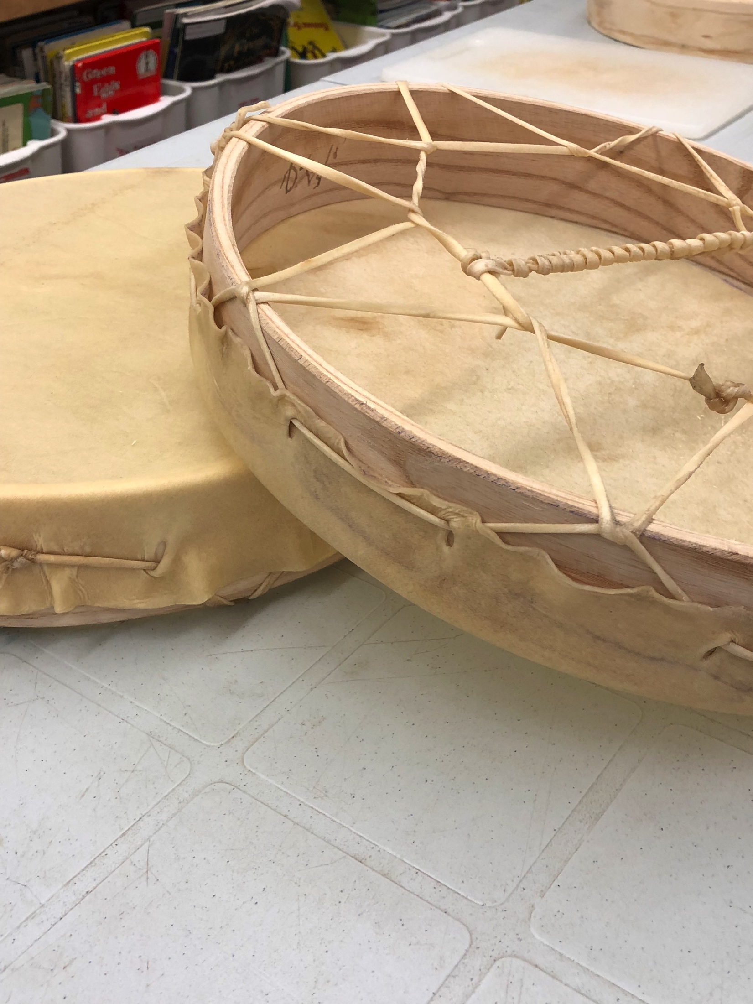
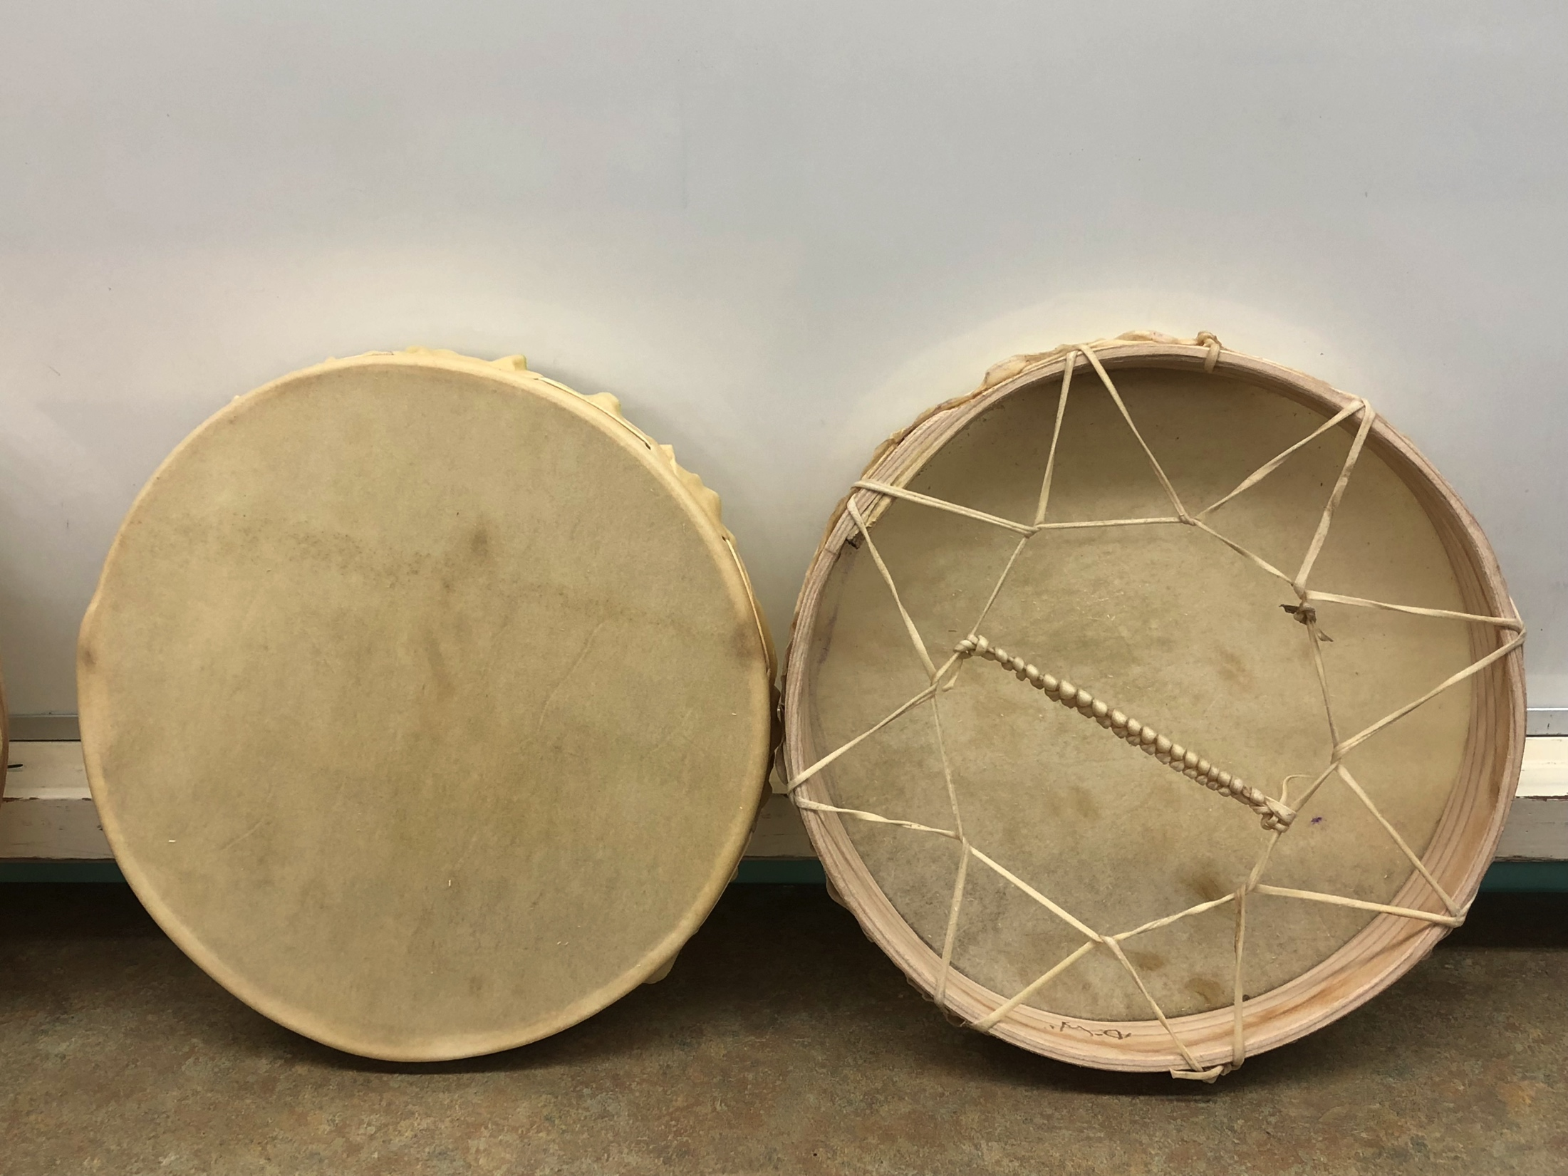
Finishing Touches

Slide 7
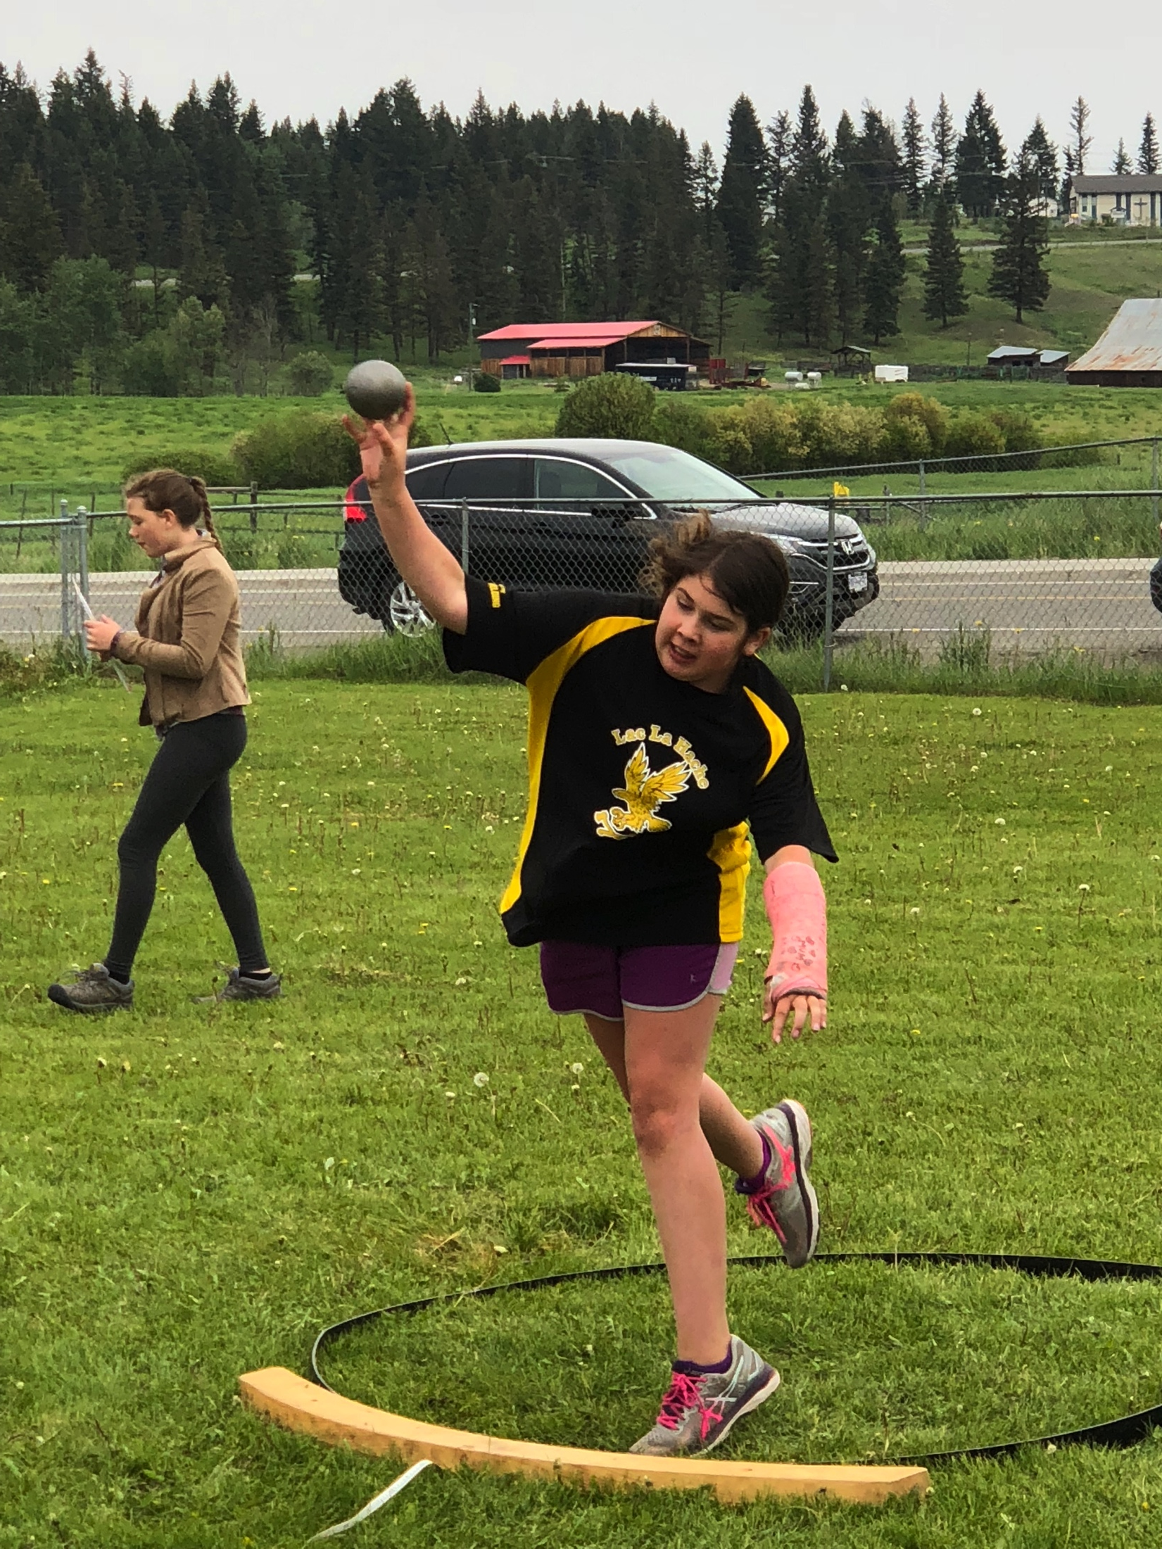
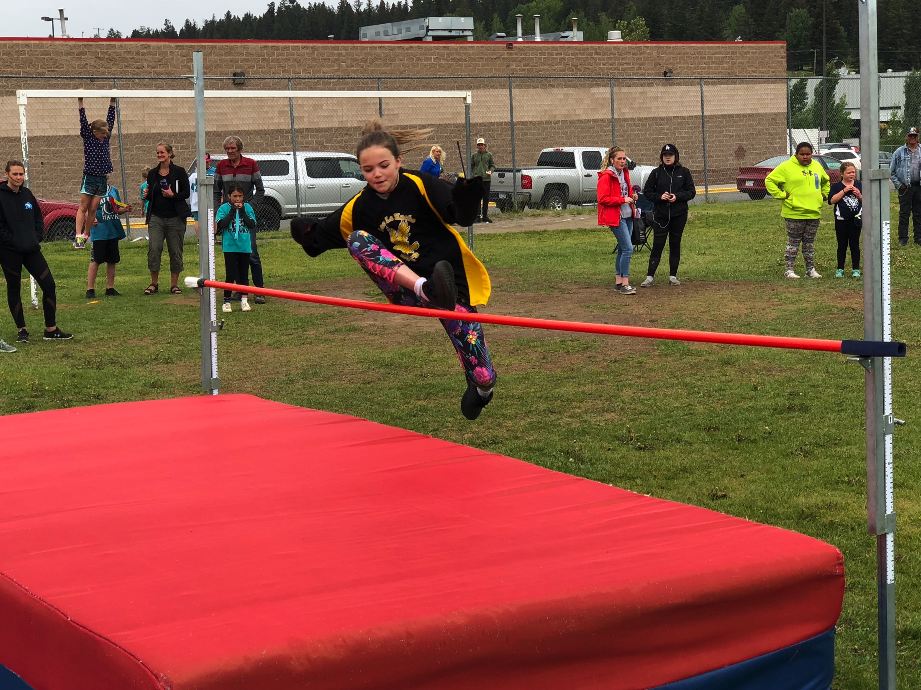
Track and Field Coaching
South End Track Meet at 100 Mile Elementary

Slide 8
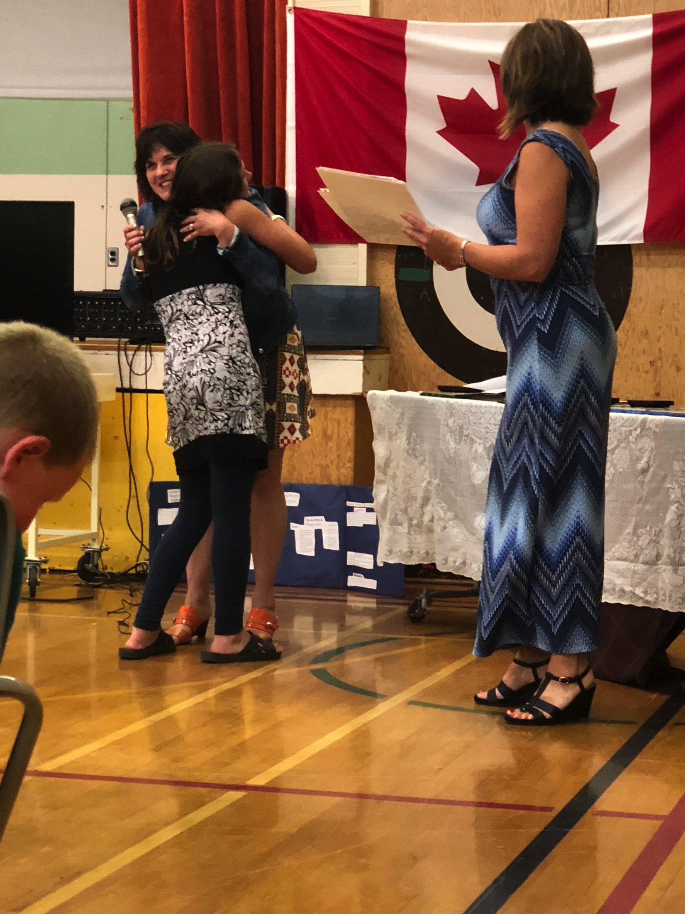
Year End Awards Ceremony ~ Lac La Hache Elementary

Slide 9
A heartfelt goodbye from my class!

Slide 10
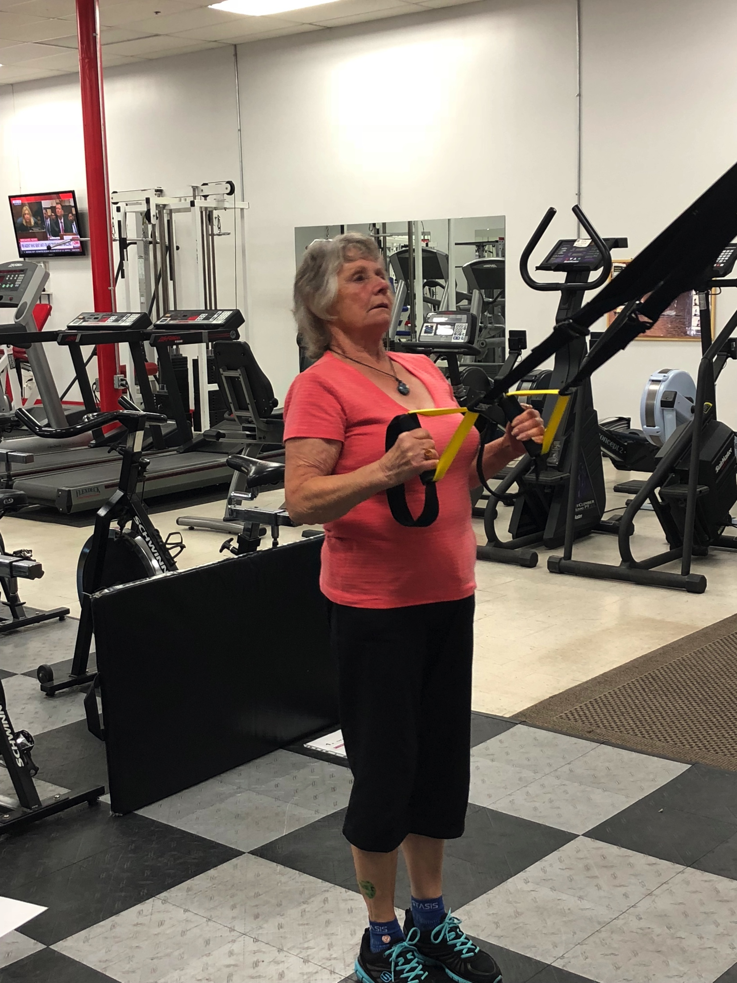
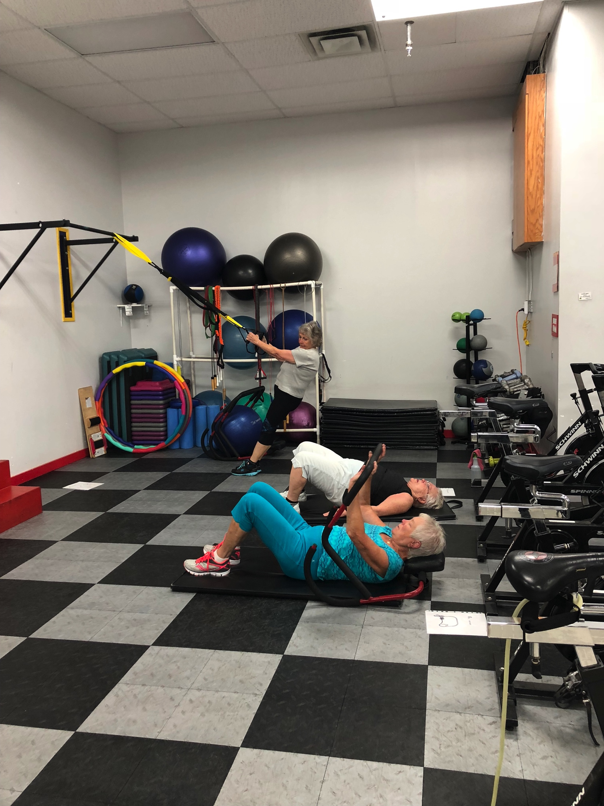
Business Ownership: Action Fitness
Ladies Circuit Class

Slide 11
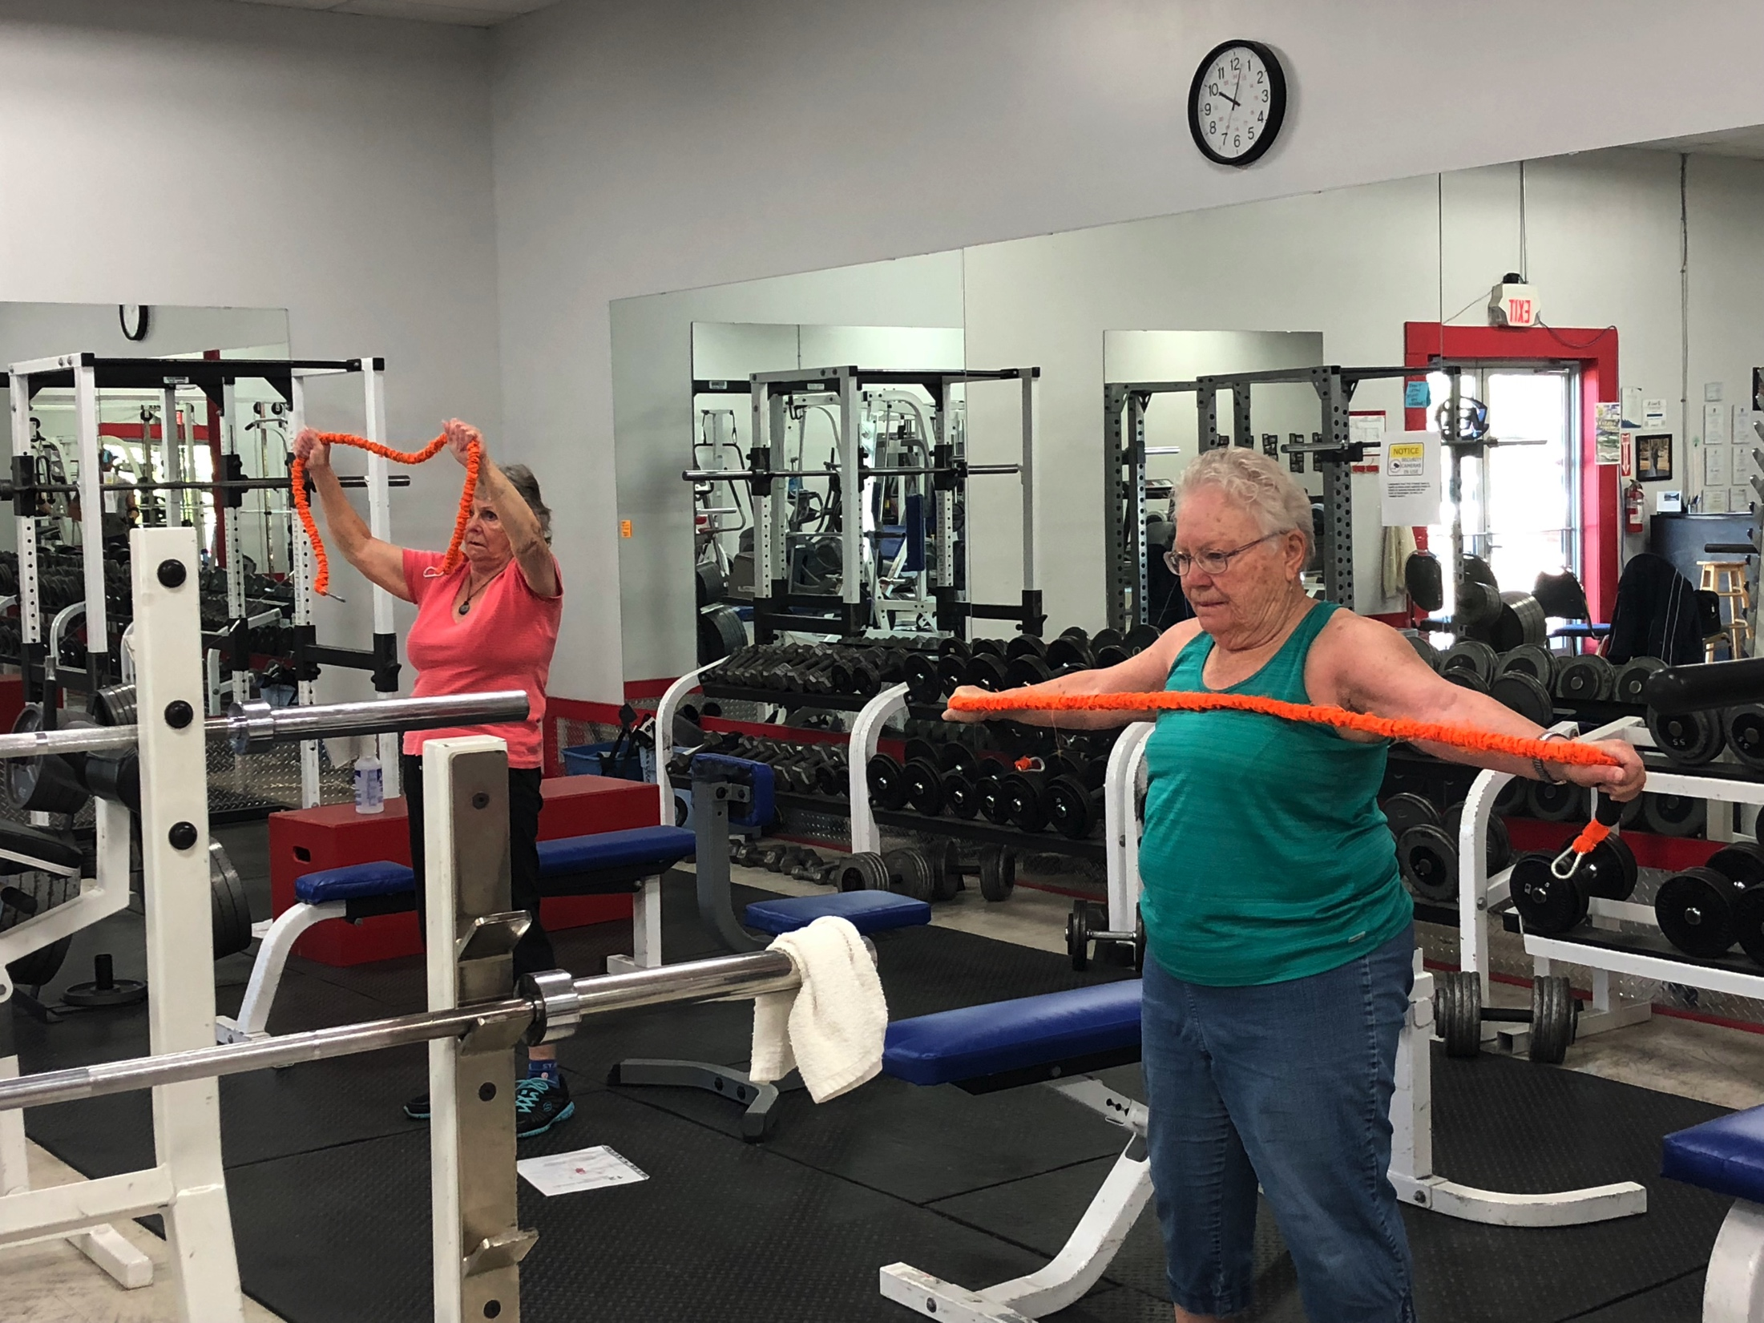
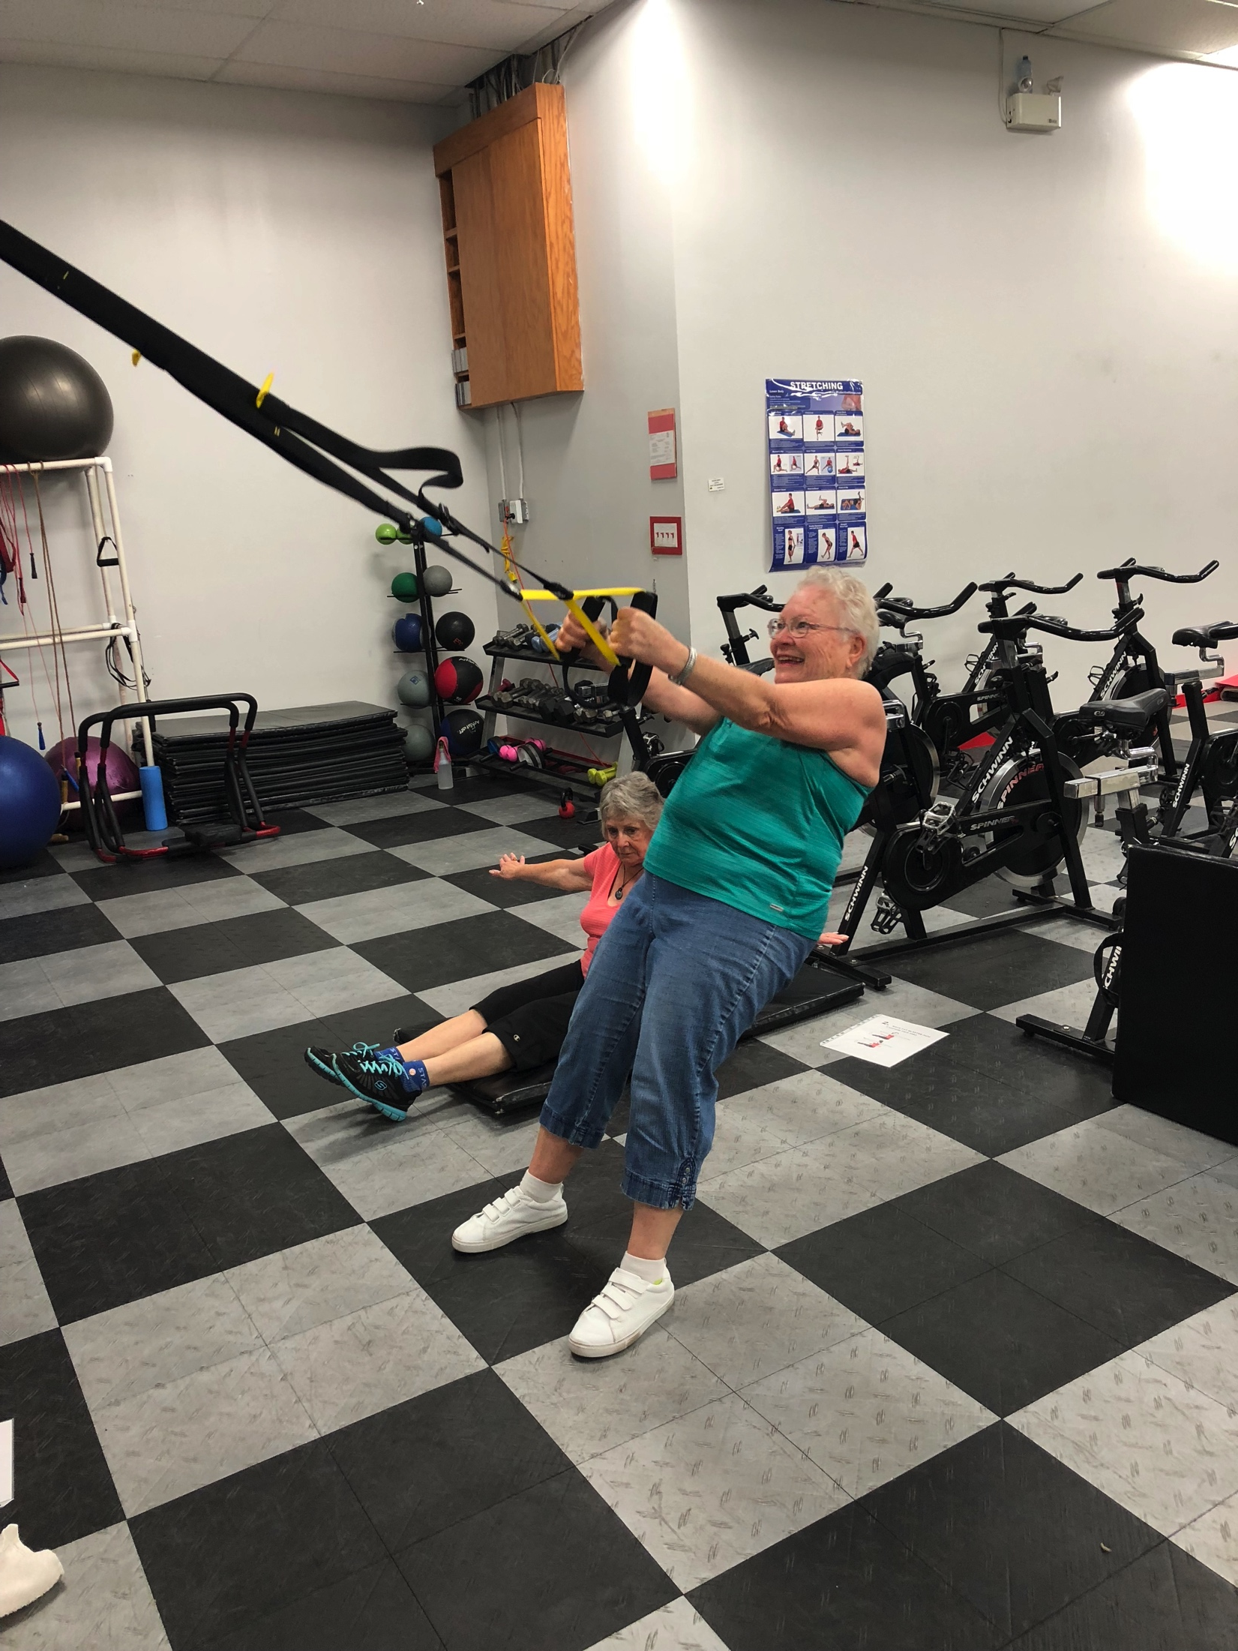
Ladies Circuit Class

Slide 12
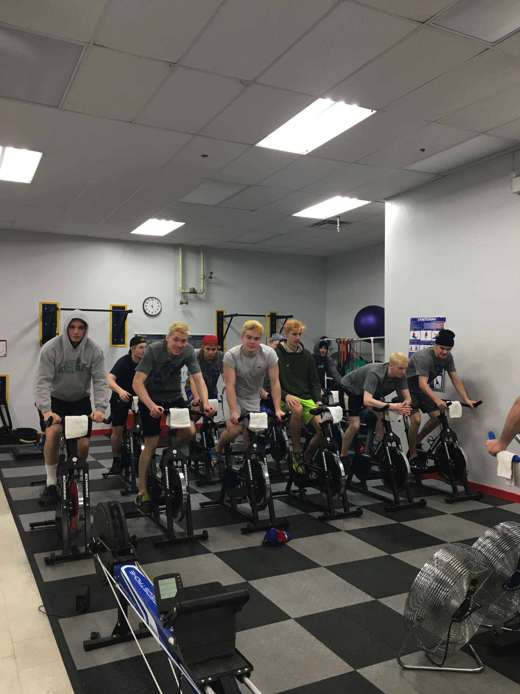
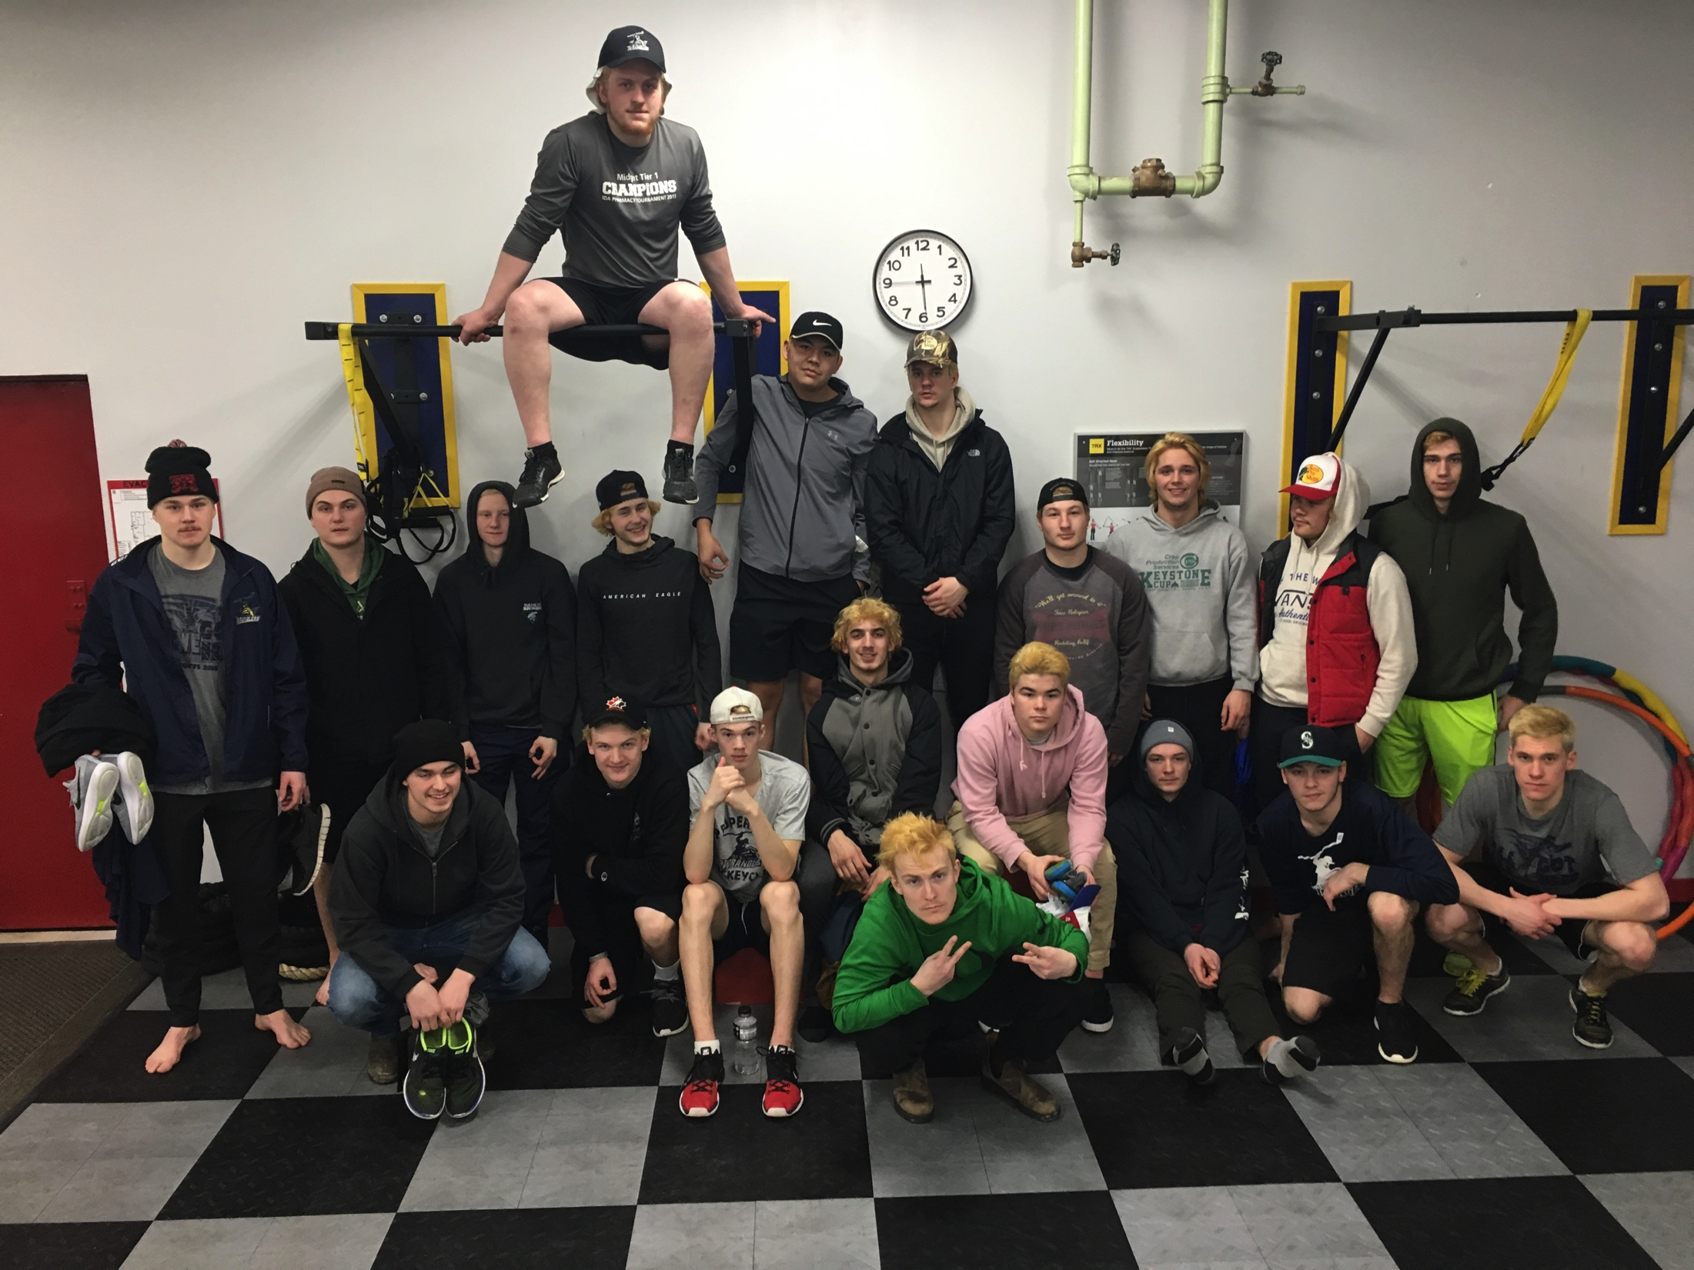
Junior B Hockey Training
The 100 Mile House Wranglers, 2016

Slide 13
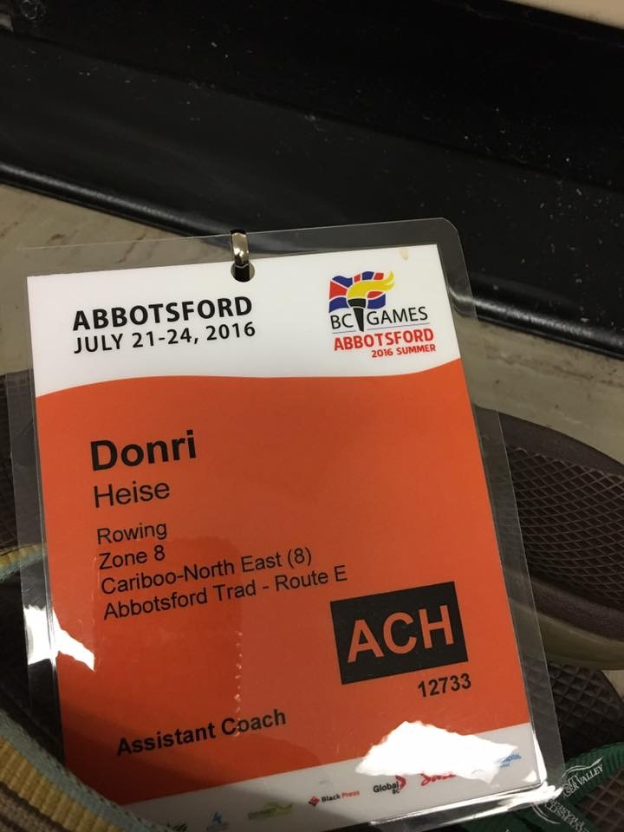
Rowing
BC Summer Games 2016
ID is in my maiden name. I was married August 6th of the same year.

Slide 14
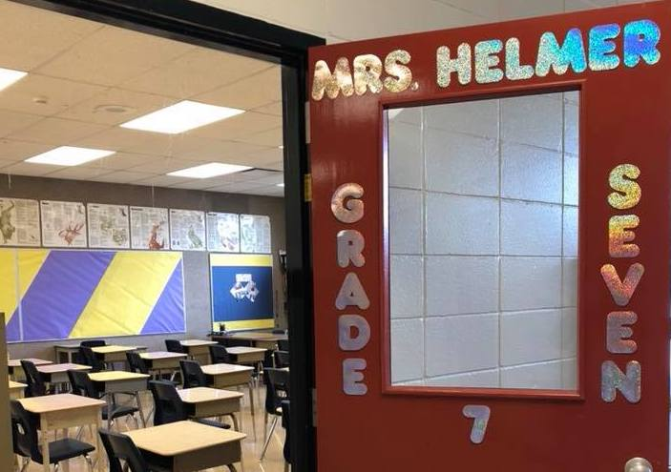
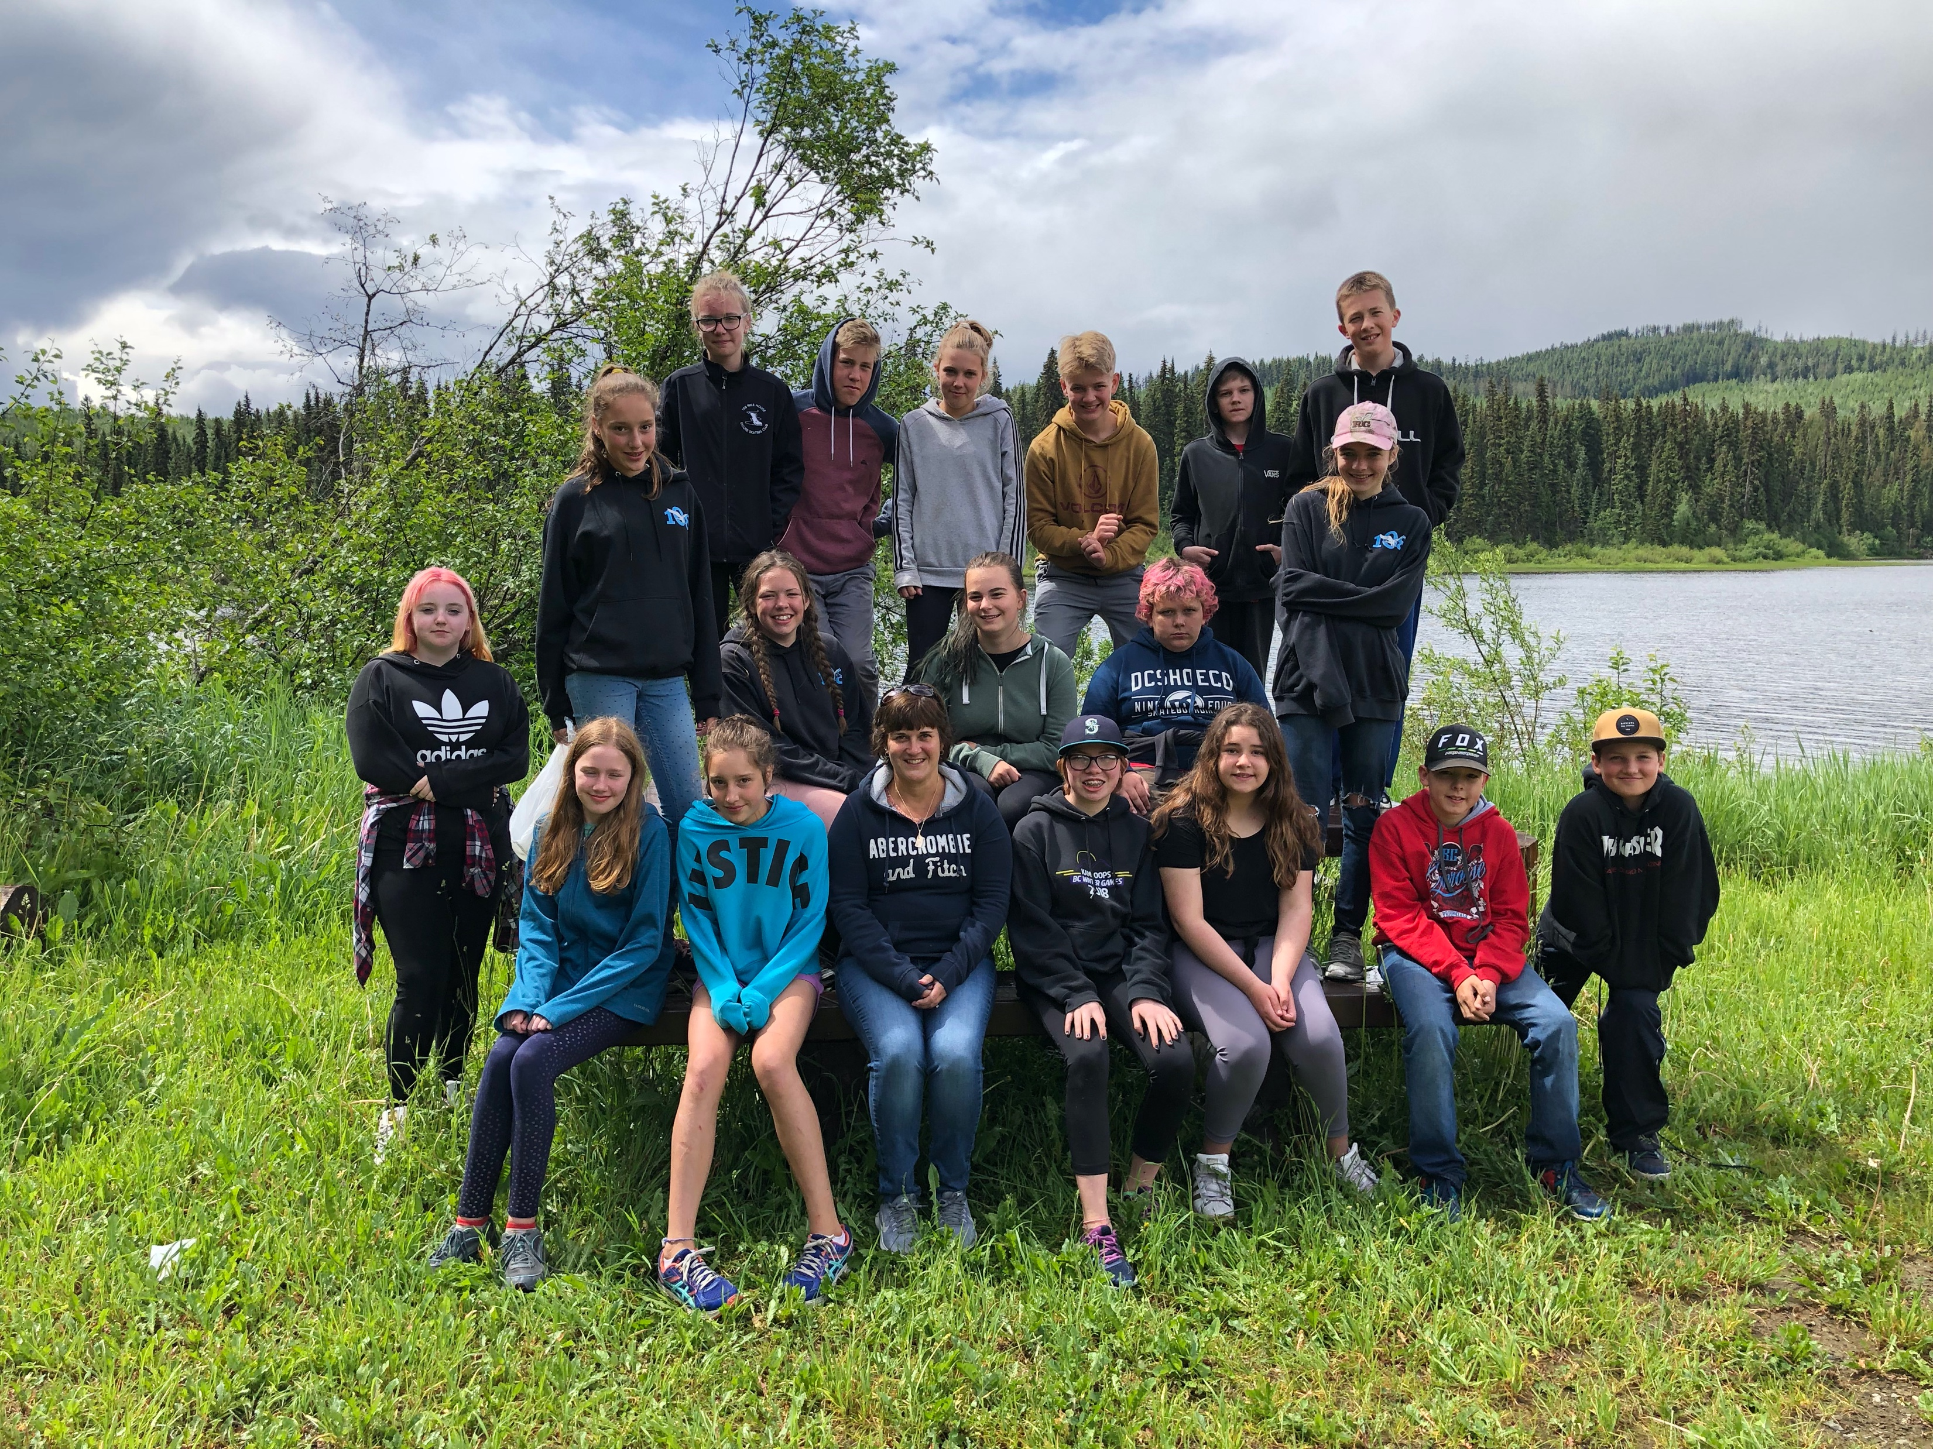
Full-Time Grade Seven Assignment
Mile 108 Elementary

Slide 15
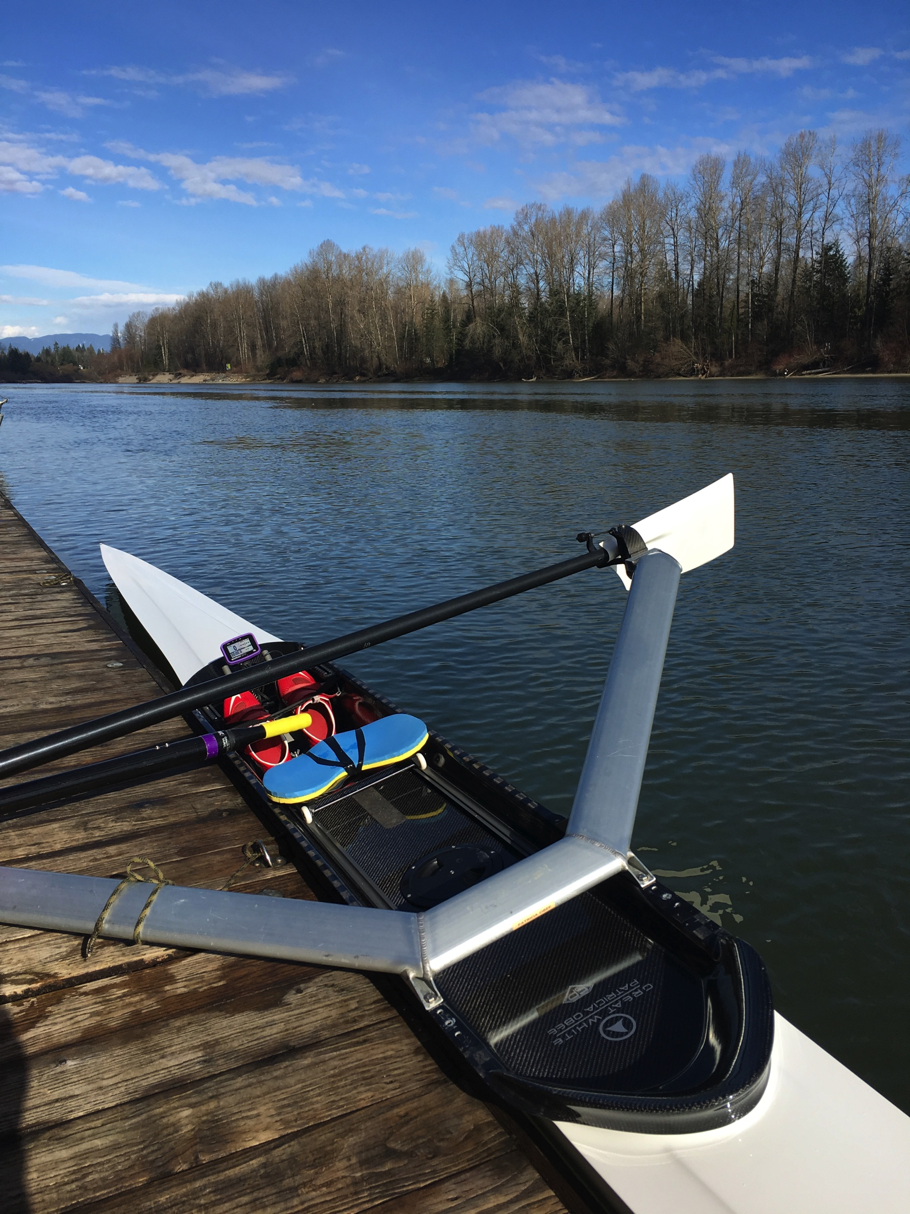
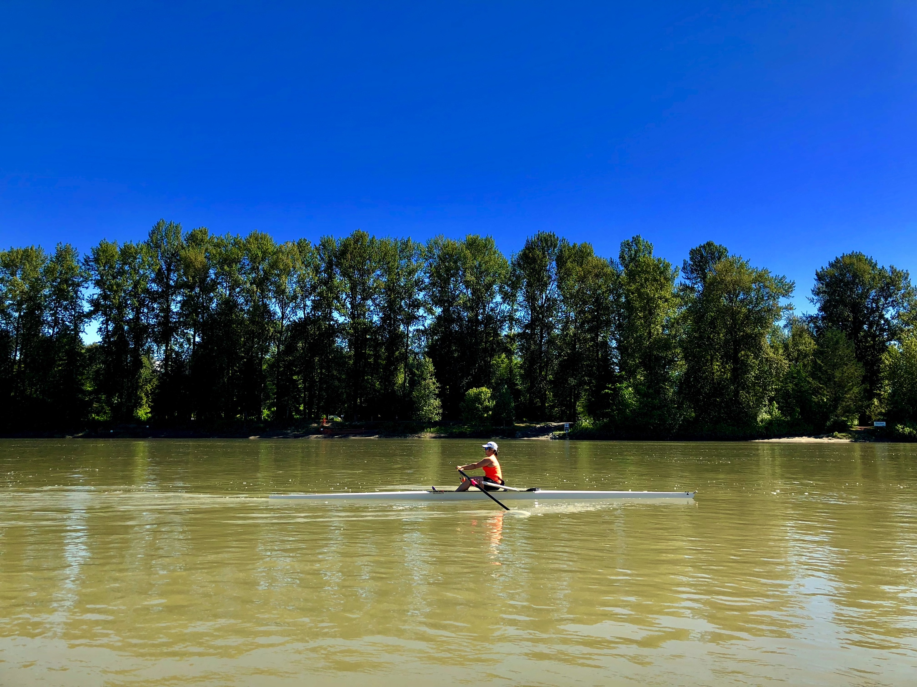
Rowing
It is a hobby and a passion that inspired my own learning and the coaching of others.

